Slide 1
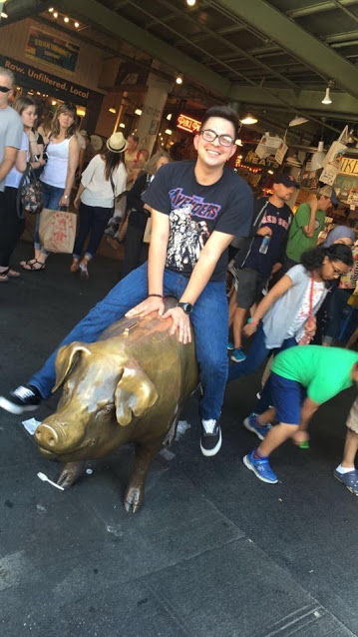
Luis Garcia
Class Of 2017
Exit Interview

Slide 2
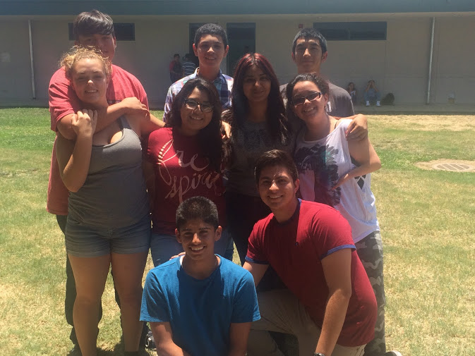
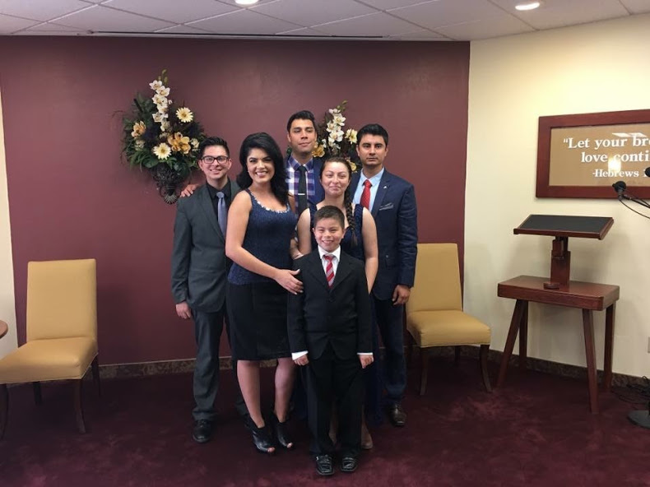
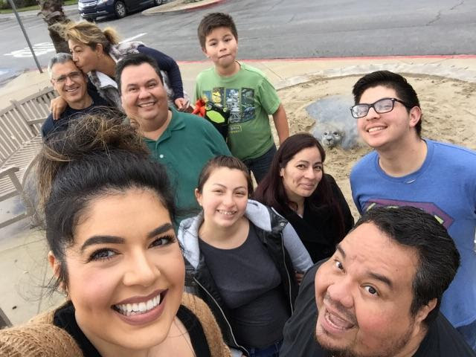
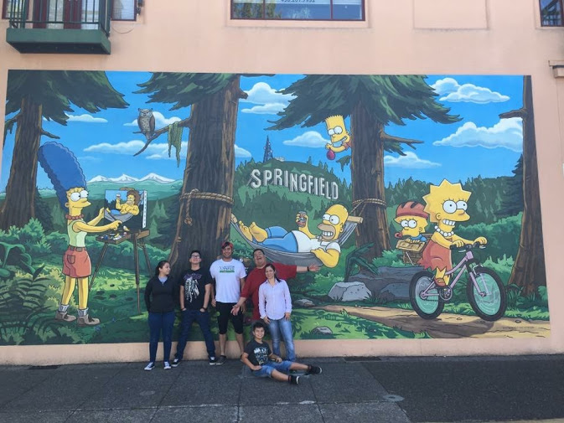
About Me
Friends & Family
Oldest of 3, outgoing and friendly
Intelligent Student
Clubs: Lindsay Tech Club
Hobbies
Cooking and being outside

Slide 3
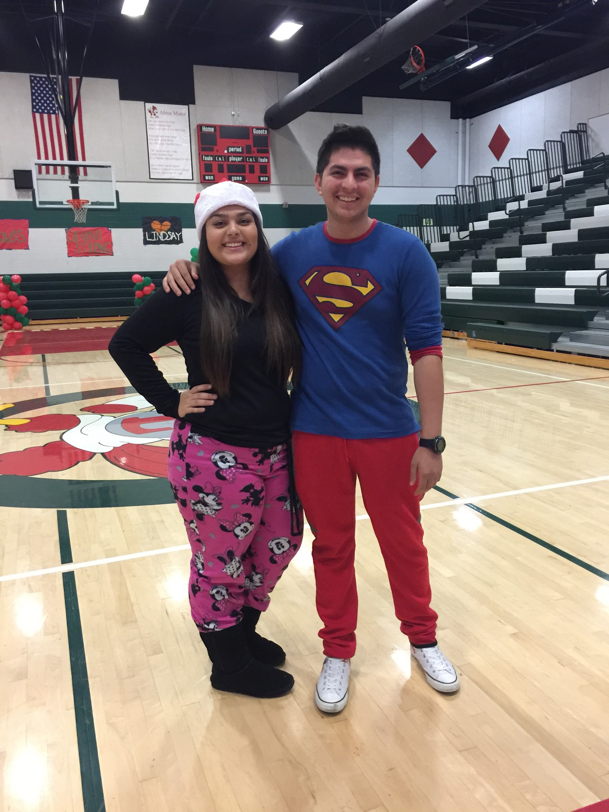
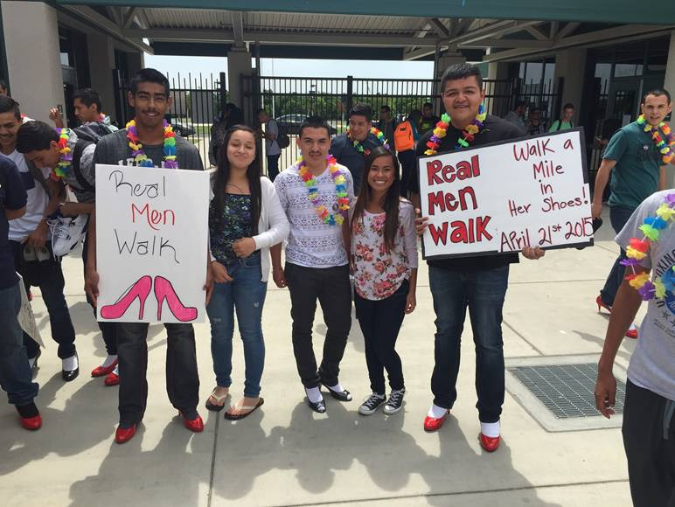
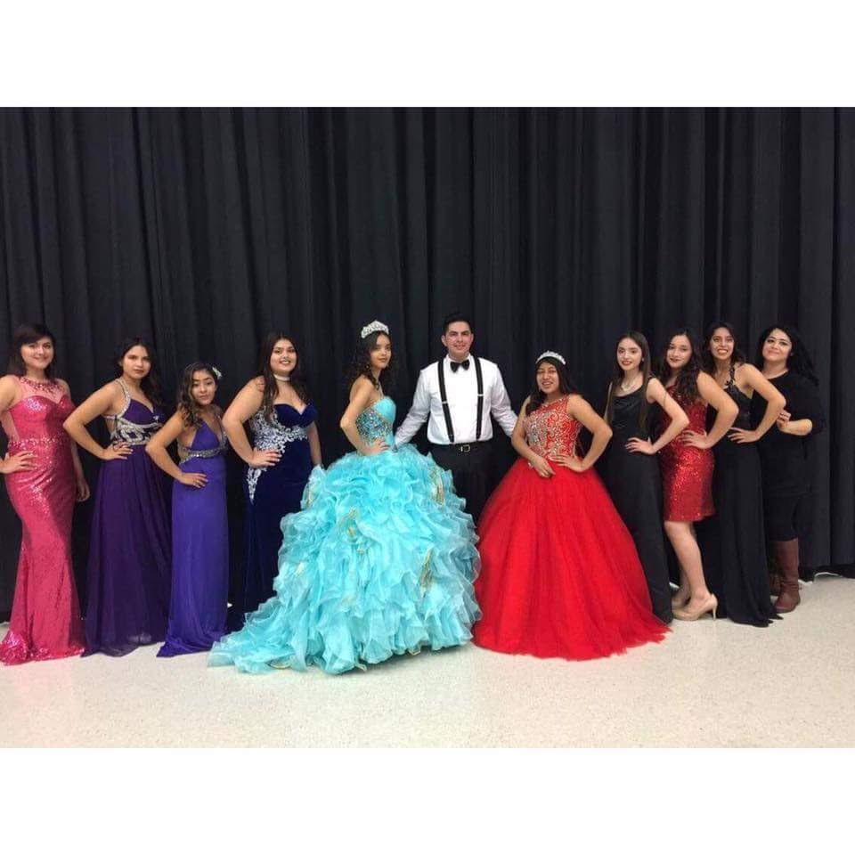
High School Experience
Walking on Heels
Getting out of my comfort zone
Rallies & having fun

Slide 4
Job Shadow
Mechanic, I love fixing cars
Future: best Mechanic in the Valley
Exciting and felt like home
The way Mr. Mejia explained
Hands on, a lot of movement
I see myself doing it

Slide 5
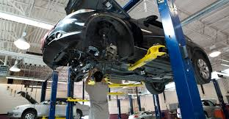
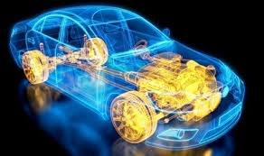
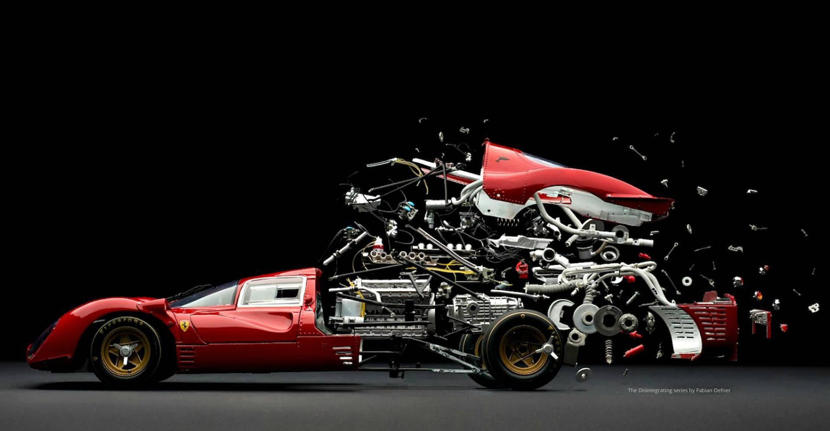
Pathway
Pathway: Automotive; it leads to my career
Gives me a head start in my career
Push myself if i want to achieve it

Slide 6
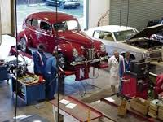
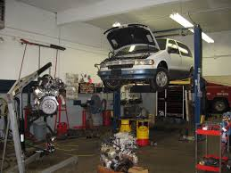
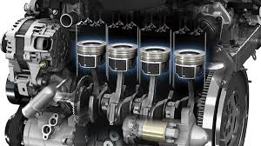
Post-High School Plans
Reedley Community College
Best for automotives
Local & faster
Family supports me 100%
Short term: Get few degrees, & get a job in automotive
Long Term: Open a shop, move to Washington.

Slide 7
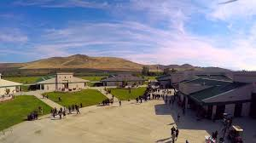
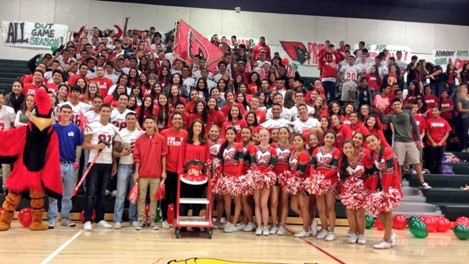
Leaving LHS
Exciting leaving lhs and moving on
Made me think more outside of the box
Teachers would help me, push me
Know where I am , how to improve

